Slide 1
Road Analysis System
Georg Gasser Remzi Cetin

Slide 2
Idea and Features
Parking Slot Detection
Traffic Jam Detection
Special Events (not included)
Notes:
Our idea was to extend and improve currently available software like Google Maps for navigating around in the city
Getting somewhere works pretty well but sometimes traffic can be a problem as well as finding a free parking space
So we cam up with the following features
Parking Slot Detection with images provided by a parking lot
Traffic Jams Detection to know how seveire the traffic on a certain road is
We wanted to add some special events that can occur like a road blockage, construction site, heavy snowfall or a car crash but since we are only 2 people we decided to split the work so 1 person develops one feature
In our workflow we can show you how we exactly did this

Slide 3
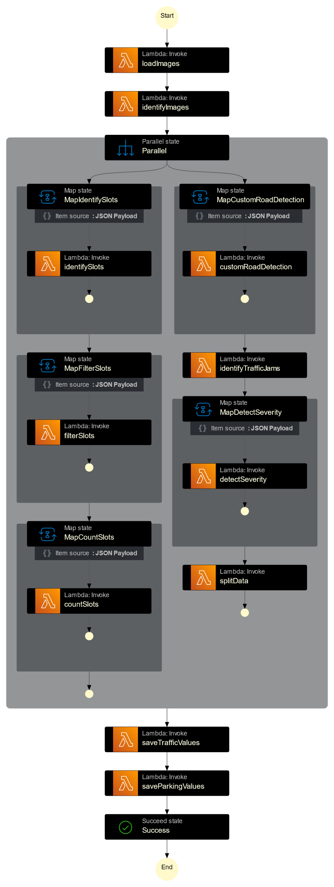
Workflow
Notes:
Load Images gets all the images from the S3 Bucket
Identify Images splits our list of images into either parking lot or road so it is seperated per feature
Everything that is next is executed parallel

Slide 4
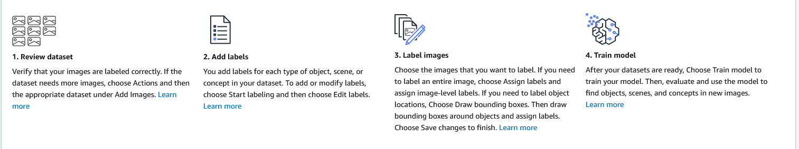
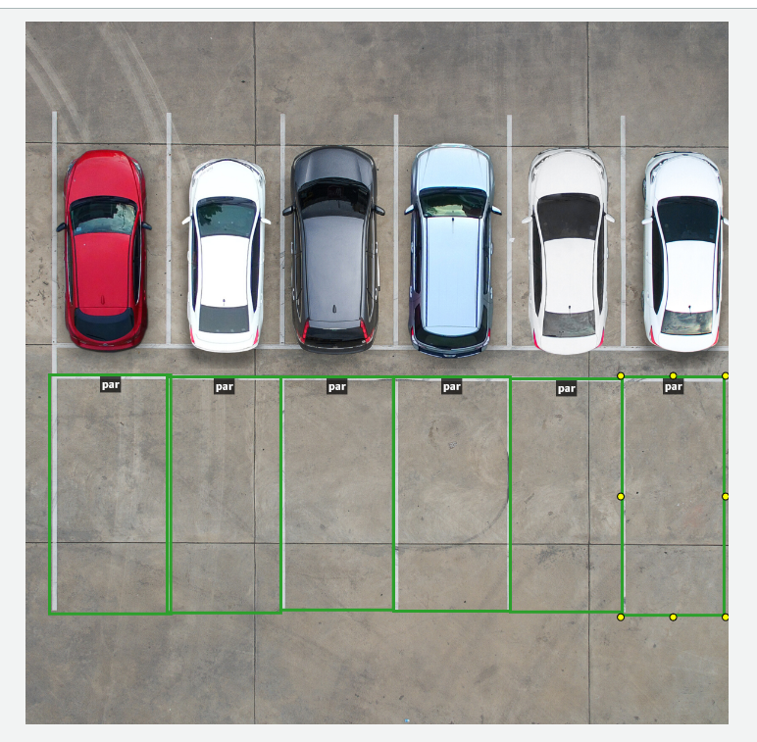
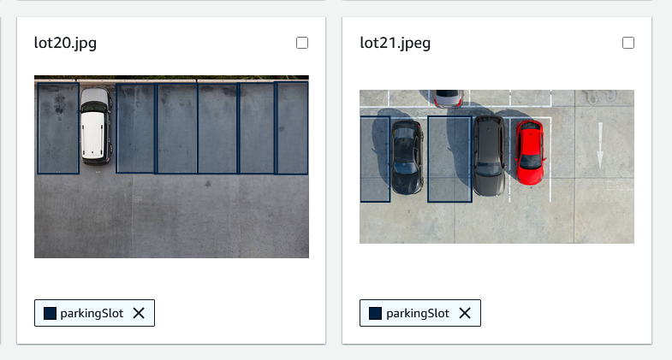
Workflow
Notes:
Amazon Rekognition is a really good model for detecting stuff in images, but if you need something that is not already included you need a custom model
We had to create one to detect parking slots and roads
To detect parking slots i had to upload a couple of images first, then create a label for ParkingSlot and then draw bounding boxes where parking slots are in the images, some images are used as a training dataset and the others to evaluate it, of course we did not have the time to have a huge dataset and draw a lot of bounding boxes so our model was not that good but certainly usable

Slide 5
Workflow
Notes:
Identify Slots
- starts our Rekognition Model and calls a function that detects all custom labels in the image which is only Parking Slot in this case and returns them as a list
Filter Slots
- calculates a margin for how big the box can be for the Parking Slot so we can drop invalid entries out of our list because they can clearly not be a parking slot if they are not within the margin and then returns the list of valid slots
Count Slots
- simply takes the length of the list – 1 because the last entry of the list is the image name itself to know which image the number of slots belong to because we have everything in parallel
And finally we have an array with subarrays that look like this [slotCount, imageName]

Slide 6
Workflow
Notes:
In the end we save all values to our S3 bucket

Slide 7
(Live Demo)
….

